Slide 1
Marginal Structural Models
Robins, Hernan, Brumback (2000)
Hernan, Brumback, Robins (2000)

Slide 2
MSM and Causal Inference in Epidemiology
First sections describe the problem of time-dependent confounding.
Later sections describe MSM.
Outcome of interest is a binary Y at the end of follow-up.
Treatment may change over time.
There are time-dependent confounders.

Slide 3
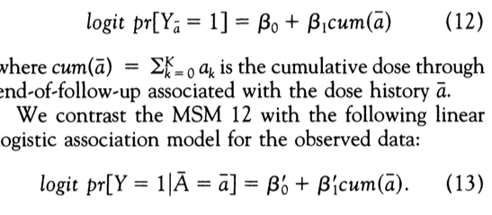
Marginal Structural Model

Slide 4
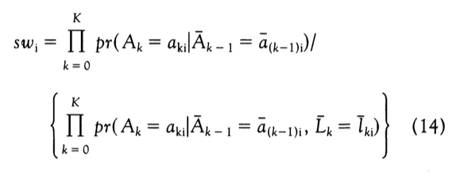
Stabilized Treatment Weights

Slide 5
Estimating Probability of Treatment using time-varying covariates

Slide 6
Estimating Probability of Treatment using baseline covariates

Slide 7
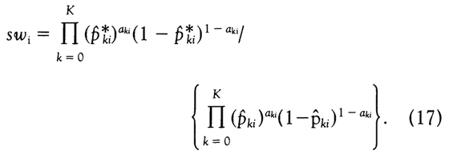
Treatment Weights

Slide 8
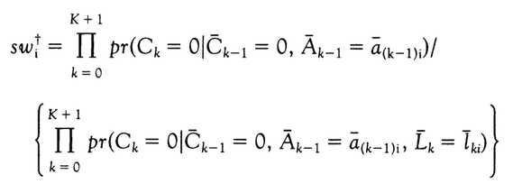
Censoring Weights

Slide 9
MSM among HIV+ MSM
Impact of zidovudine on mortality
Time to event analysis
Time-varying confounders
Once someone starts zidovudine, they’re assumed to stay on it for life

Slide 10
Marginal Structural Model
Interpretation of beta1:
exp(beta1) is the ratio of the hazard rate for mortality at any time t had all subjects been continuously exposed to zidovudine compared with the hazard rate at time t had all subjects remained unexposed, conditional on baseline covariates V.

Slide 11
Pooled Logistic Regression to Approximate Cox Model and incorporate Time-varying Weights
-Pooled logistic regression is simply a discrete hazard model
-Logistic regression only among those who have not yet had the event
-Intercept flexibly modeled by including time in model with splines
-Covariates V are necessary because numerator of stabilized weights included V, but otherwise not needed.

Slide 12
Stabilized Treatment Weights

Slide 13
Stabilized Censoring Weights

Slide 14
In practice
Usually requires breaking up time into discrete intervals (e.g., months or 3-month periods).
Observations are often not measured at each interval, so may require some imputation or last observations carried forward.
Data prep is usually the most time-consuming part.
Within each interval, fit 2 (pooled) logistic regression models for the probability of starting treatment over time
using baseline covariates only (or not) [numerator of SW]
Using baseline and time-varying covariates [denom of SW]

Slide 15
In practice (2)
Within each interval, fit 2 pooled logistic regression models for the probability of being censored
using baseline covariates only (or not)
Using baseline and time-varying covariates
Compute predicted probability of patient following treatment history they followed thru time t
Using baseline covariates
Using baseline and time-varying covariates
Compute predicted probability of patient not being censored by time t
Using baseline covariates
Using baseline and time-varying covariates

Slide 16
In practice (3)
Multiply probabilities together to create time-varying inverse probability weights.
Weights may need to be windsorized (truncated) if extreme.
Fit a pooled logistic regression model using time-varying weights.
Time included in the model using flexible functions (e.g., splines)
Variances are estimated using robust standard errors
i.e., GEE with independence working covariance matrices

