Slide 1

I.
REVIEW OF BIOSTATISTICS 1 AND SIMPLE LINEAR REGRESSION
Distinction between a parameter and a statistic
The normal distribution
Inference from a known sample about an unknown target population
Simple linear regression: Assessing simple relationships between two continuous variables
Interpreting the output from a linear regression program. Analyzing data with Stata
Plotting linear regression lines with confidence bands
Making inferences from simple linear regression models
Lowess regression and residual plots. How do you know you have the right model?
Transforming data to improve model fit
Comparing slopes from two independent linear regressions
© William D. Dupont, 2010, 2011
Use of this file is restricted by a Creative Commons Attribution Non-Commercial Share Alike license.
See http://creativecommons.org/about/licenses for details.

Slide 2
I.
REVIEW OF BIOSTATISTICS 1 AND SIMPLE LINEAR REGRESSION
1.
Parameters, Statistics, and Statistical Notation
a)
Normal distribution
This distribution is defined by two
parameters:

Slide 3
b)
Mean
μ
c)
Variance
σ
2
=
mean squared distance of a statistic from its mean.
d)
Standard deviation
σ

Slide 4
e)
Sample mean and central tendency
Given a sample
, the
sample mean
x
=
å
x
/n
is a measure of
central tendency.
i
if all members of the population have an equal chance of being sampled.
x =17.2
45
•
40
•
•
•
•
•
•
•
•
35
•
•
•
•
Birthweight (g/100)
•
•
•
•
•
•
•
30
•
•
•
•
•
•
•
•
•
25
•
•
20
5
10
15
20
25
30
Estriol (mg/24 hr)
Rosner. 2006: Table 11.1
Green & Touchstone. Am J Obs Gyn 1963;85:1-9

Slide 5
f)
Residuals and dispersion
The i^{th}
residual
=
The average residual length =
is an intuitive measure of
dispersion:
the extent to which observations vary from each other.
It is rarely used because it is difficult to work with mathematically.
45
•
40
•
•
•
•
•
•
•
•
35
•
•
•
•
Birthweight (g/100)
•
•
•
•
•
•
•
30
•
•
•
•
•
•
•
•
•
25
•
•
20
5
10
15
20
25
30
Estriol (mg/24 hr)
Rosner. 2006: Table 11.1
Green & Touchstone. Am J Obs Gyn 1963;85:1-9

Slide 6
g)
Sample variance
{1.1}
h)
Sample standard deviation
is the most common measure of dispersion.
s
x
=
4.75
45
•
40
•
•
•
•
•
•
•
•
35
•
•
•
•
Birthweight (g/100)
•
•
•
•
•
•
•
30
•
•
•
•
•
•
•
•
•
25
•
•
20
5
10
15
20
25
30
Estriol (mg/24 hr)
Rosner. 2006: Table 11.1
Green & Touchstone. Am J Obs Gyn 1963;85:1-9

Slide 7
i)
Expected value
The
expected value
of a statistic is its average value from a
very large number of experiments.
The expected value of both x_{i} and x is μ.
The expected value of
s
2
is
σ
2
.
We write
j)
Unbiased estimate of a parameter
A statistic is
unbiased estimate
of a parameter if its
expected value equals the parameter.
is an unbiased estimate of μ since
The denominator of is n-1 rather than n in order to make s² an unbiased estimate of σ².

Slide 8
Elementary Statistics for Continuous Bivariate Data
2.
a) Covariance
x=17.2
45
•
40
•
•
•
•
•
•
•
•
35
•
•
•
•
Birthweight (g/100)
•
•
•
•
y=32
•
•
•
30
•
•
•
•
•
•
•
•
•
25
•
•
20
5
10
15
20
25
30
Estriol (mg/24 hr)
Rosner. 2006: Table 11.1
Green & Touchstone. Am J Obs Gyn 1963;85:1-9
Given paired observations
, the
covariance
expected mean product of paired residuals

Slide 9
b) Sample covariance
Given a sample of size
is estimated by the
sample covariance
x=17.2
45
•
40
•
•
•
•
•
•
•
•
35
•
•
•
•
Birthweight (g/100)
•
•
•
•
y=32
•
•
•
30
•
•
•
•
•
•
•
•
•
25
•
•
20
5
10
15
20
25
30
Estriol (mg/24 hr)
Rosner. 2006: Table 11.1
Green & Touchstone. Am J Obs Gyn 1963;85:1-9

Slide 10
Note:
i)
Product of paired residuals may be positive or negative.
ii)
If x and y are
independent
these terms cancel each
out and
σ_{xy} = 0
iii)
σ_{xy} > 0 if most pairs fall in the upper right or lower left quadrant of the figure.
x=17.2
45
•
40
•
•
•
•
•
•
•
•
35
•
•
•
•
Birthweight (g/100)
•
•
•
•
y=32
•
•
•
30
•
•
•
•
•
•
•
•
•
25
•
•
20
5
10
15
20
25
30
Estriol (mg/24 hr)
Rosner. 2006: Table 11.1
Green & Touchstone. Am J Obs Gyn 1963;85:1-9

Slide 11
c)
Correlation coefficient
is estimated by
{1.2}
r = 1
r = -1
r = 0
0 < r < 1

Slide 16
3.
Simple Linear Regression
a) The Model
We assume that
y_{i} = α + βx_{i} + ε_{i}
Where x_{i} is a variable observed on the i^{th} patient
ε_{i}
is assumed to be normally and independently distributed with mean 0 and standard deviation σ
y_{i}
is the response from the i^{th} patient
α and β are model parameters.
The expected value of y_{i} is E(y_{i}) = α + βx_{i}.

Slide 17
b) Implications of linearity and homoscedasticity.
Linear
Homoscedastic
Non-Linear
Heteroscedastic

Slide 18
We estimate and by minimizing the sum of the squared residuals
Rosner. 2006: Table 11.1
Green & Touchstone. Am J Obs Gyn 1963;85:1-9

Slide 19
Rosner. 2006: Table 11.1
Green & Touchstone. Am J Obs Gyn 1963;85:1-9
c) Slope parameter estimate
β is estimated by b = r s_{y} /s_{x}
{1.3}
d) Intercept parameter estimate
α is estimated by a =
{1.4}

Slide 20
Rosner. 2006: Table 11.1
Green & Touchstone. Am J Obs Gyn 1963;85:1-9
e) Least squares estimation
= a + bx is the
least squares estimate
of α + βx.

Slide 21
Note:
i) is an
unbiased
estimate of α + βx.
ii) Since
= a + bx can be rewritten
Hence the regression line passes through
iii) Since b = r s_{y} /s_{x}
b → 0 as r → 0 and b → s_{y} /s_{x} as r → 1
Rosner. 2006: Table 11.1
Green & Touchstone. Am J Obs Gyn 1963;85:1-9

Slide 22
4.
Historical Trivia: Origin of the Term Regression
If s_{x} = s_{y} then b = r and hence
if 1 > r > 0 and x >
Francis Galton, a 19th century pioneer of statistics who was interested in eugenics studied patterns of inheritance of all sorts of attributes and found that, for example, the sons of tall men tended to be shorter than their fathers. He called this regression toward the mean, which is where the term linear regression comes from.

Slide 23
5.
The Stata Statistical Software Package
Stata is an excellent tool for the analysis of medical data. It is far easier to use than other software of similar sophistication. However, we will be using Stata for some complex analyses and you may be puzzled by some of its responses. If so please ask. I would very much like to minimize the time you spend struggling with Stata and maximize the time you spend learning statistics. I will be available to answer questions at most times on days, evenings and weekends.
If you have not used Stata since Biometry I you are probably very rusty. Here are a few reminders and aids that may help.

Slide 24
a) Punctuation
Proper punctuation is mandatory. If Stata gives a confusing error message, the first thing to check is your punctuation. Stata commands are modified by qualifiers and options. Qualifiers precede options and there must be a comma before the first option.
For example
table age if treat==1 ,by(sex)
Might produce a table showing the number of men and women of different ages receiving treatment 1.
if treat==1 is a qualifier and by(sex) is an option.
Without the comma, Stata will not recognize by(sex) as a valid option to the table command.
Some command prefixes must be followed by a colon.

Slide 25
b) Capitalization
Stata
variables
and commands are
case sensitive.
That is, Stata considers age and Age to be two distinct variables. In general, I recommend that you always use lower case variables. Sometimes Stata will create variables for you that contain upper case letters. You must use the correct capitalization when referring to these variables.
c) Command summary
At the end of the text book is a summary of most of the commands that are needed in this course. These may be helpful in answering your class exercises.
d) GUI interface
You can avoid learning Stata syntax by using their pull down menus. These menus generate rather complex syntax but feel free to use them if it makes the exercises easier.
This interface is extensively documented in my text. See Section 1.3.8 on page 15.

Slide 26
d) Data files and log files
You may download the Stata data files, log files,do files and these lecture notes that you will need from this course from the web at:
http://biostat.mc.vanderbilt.edu/BiostatIILectureNotes
then click on the desired links for data files, Stata log files, do files or lecture notes. Pages for the class schedule, student names and exercises are password protected. The username and password for these pages is the same as for the other MPH courses except that the second letter of the username must be lower case while the other letters must be upper case. (This is due to a camel-case requirement for usernames on the Biostatistics wiki that I can’t get around.)
The class exercises are very similar to the examples discussed in class. You can save yourself time by cutting and pasting commands from these log files into your Stata Command window, or by modifying these do files.

Slide 27
e) Other things you should know
It is important that you can do the following by the end of today.
Open, close and save Stata data files.
Review and modify data in the Stata editor.
Open and close Stata log files.
Paste commands from the Review window into the Command window.
Copy and paste Stata graphics into your word processor.
Copy and paste commands from your external text editor into the command window.

Slide 28
6. Color Coding Conventions for Stata Log Files
a) Introductory Example
. * RosnerTable11.1.log {1}
. *
. * Examine the Stata data set from Table 11.1 of Rosner, p. 554 {2}
. * See Green & Touchstone 1963
. *
. use "C:\MyDocs\MPH\LectureNotes\rostab11.dta", clear {3}
. * Data > Describe data > Describe data in memory
. describe
Contains data from \\PMPC158\mph\analyses\linear_reg\stata\rostab11.dta
obs: 31
vars: 3 10 Nov 1998 12:34
size: 496 (99.9% of memory free)
------------------------------------------------------------------------
1. id float %9.0g
2. estriol float %9.0g Estriol (mg/24 hr)
3. bweight float %9.0g Birth Weight (g/100)
------------------------------------------------------------------------
Sorted by: estriol

Slide 29
{1} You will find this and other Stata log files discussed in this course at: http://biostat.mc.vanderbilt.edu/BiostatisticsTwoClassPage
and clicking on Example Logs and Data from Lecture Notes.
Most of the class exercises may be completed by performing Stata sessions that are similar to those discussed in class.
{2} I have adopted the following color coding conventions for Stata log files throughout these notes.
Red is used for Stata comment statements. Also, red numbers in braces in the right margin refer to comments at the end of the program and are not part of the programming code. Red text on Stata output is my annotation rather than text printed by Stata.
Stata command words, qualifiers and options are written in blue
Variables and data set names are written in black, as are algebraic or logical formulas
Stata output is written in green
{3} The use command reads the Rosner data into memory. The previous contents of memory are purged.

Slide 30
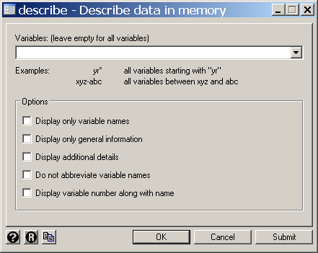

Slide 31
. * Data > Describe data > List data
. list estriol bweight if estriol >= 25 {4}
estriol bweight
29. 25 39
30. 25 32
31. 27 34
{4} List the variables of estriol and birthweight for those patients whose estriol values are at least 25.
There is no obvious distinction between command modifiers like if and command options. In general, modifiers apply to most Stata commands while options are specific to a given class of commands. See you manuals and command summary in the text.

Slide 32
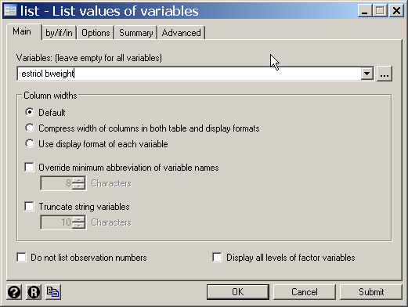
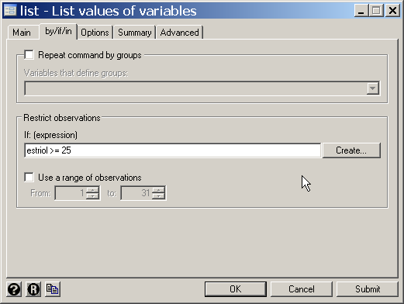

Slide 33
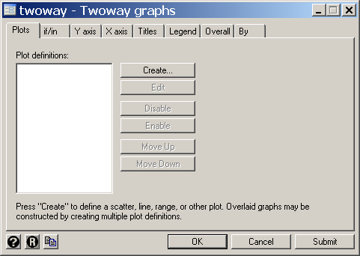
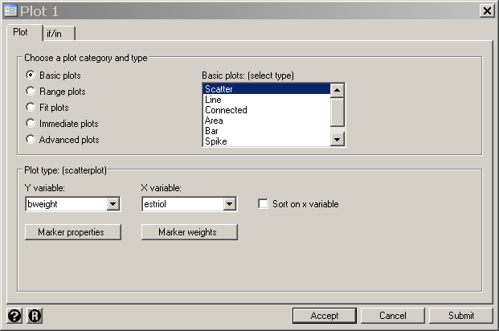
. * Graphics > Twoway graph (scatter, line, etc.)
. twoway scatter bweight estriol {5}
{5} Draw a scatter plot of birth weight against estriol levels.

Slide 35
7. Linear Regression with Stata
a) Running a simple linear regression program
    . * Birth_Weight.LR.log
    . *
    . * Linear regression of birth weight on estriol
    . * See Rosner, Table 11.1, p554, and Green & Touchstone 1963
    . *
    . use C:\MyDocs\MPH\ANALYSES\LINEAR_REG\Stata\rostab11.dta , clear
    . * Statistics > Linear models and related > Linear regression
    . regress bweight estriol {1}
{1} This command analyses the following model.
E(bweight) = α + estriol * β
Of particular interest is to estimate the slope parameter β and to test that the null hypothesis that β = 0.

Slide 36
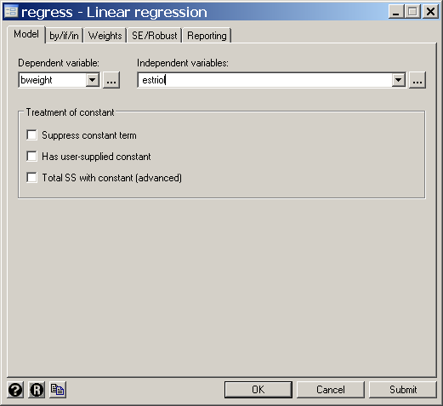

Slide 37
{2} The Total Sum of Squares (TSS) = 674 can be shown to equal
, the total squared variation in y.
{3} The Model Sum of Squares (MSS) = 250.6 equals , which is the squared variation explained by the model.
Source | SS df MS Number of obs = 31
---------+------------------------------------ F( 1, 29) = 17.16
Model | 250.574476 1 250.574476 Prob > F = 0.0003 {3}
Residual | 423.425524 n-2 = 29 s² = 14.6008801 R-squared = 0.3718
---------+------------------------------------ Adj R-squared = 0.3501
Total | 674.00 30 22.4666667 Root MSE = s = 3.8211 {2}
------------------------------------------------------------------------------
bweight | Coef. Std. Err. t P>|t| [95% Conf. Interval]
---------+--------------------------------------------------------------------
estriol |b= .6081905 se(b)= .1468117 4.14 P=0.000 .3079268 .9084541
_cons |a= 21.52343 2.620417 8.21 0.000 16.16407 26.88278
------------------------------------------------------------------------------

Slide 38
{4} The Residual or Error Sum of Squares (ESS) = 423.4 = It can be shown that SST = = SSM + SSE
{5} R-squared is the square of the correlation coefficient. It also equals MSS/TSS and hence measures the proportion of the total variation in bweight that is explained by the model. When R-squared =1, s²=0 and the data points fall on the straight line
Source | SS df MS Number of obs = 31
---------+------------------------------------ F( 1, 29) = 17.16
Model | 250.574476 1 250.574476 Prob > F = 0.0003
Residual | 423.425524 n-2 = 29 s² = 14.6008801 {4} R-squared = 0.3718 {5}
---------+------------------------------------ Adj R-squared = 0.3501
Total | 674.00 30 22.4666667 Root MSE = s = 3.8211
------------------------------------------------------------------------------
bweight | Coef. Std. Err. t P>|t| [95% Conf. Interval]
---------+--------------------------------------------------------------------
estriol |b= .6081905 se(b)= .1468117 4.14 P=0.000 .3079268 .9084541
_cons |a= 21.52343 2.620417 8.21 0.000 16.16407 26.88278
------------------------------------------------------------------------------

Slide 39
b) Interpreting output from a simple linear regression program
The estimates a and b of α and β and their standard errors are as shown.
ii) The null hypothesis that β = 0 can be rejected with P< 0.0005
iii)
{1.5}
estimates σ²
iv) s² is often called the mean sums of squares for error, or MSE.
v) s is often called the Root MSE.
Source | SS df MS Number of obs = 31
---------+------------------------------------ F( 1, 29) = 17.16
Model | 250.574476 1 250.574476 Prob > F = 0.0003
Residual | 423.425524 n-2 = 29 s² = 14.6008801 R-squared = 0.3718
---------+------------------------------------ Adj R-squared = 0.3501
Total | 674.00 30 22.4666667 Root MSE = s = 3.8211
------------------------------------------------------------------------------
bweight | Coef. Std. Err. t P>|t| [95% Conf. Interval]
---------+--------------------------------------------------------------------
estriol |b= .6081905 se(b)= .1468117 4.14 P=0.000 .3079268 .9084541
_cons |a= 21.52343 2.620417 8.21 0.000 16.16407 26.88278
------------------------------------------------------------------------------

Slide 40
var (b) =
Our certainty about the true value of β increases with the dispersion of x.

Slide 41
b) Interpreting output from a simple linear regression program
viii) se(b)=
ix) b/se(b) = .6081905/ .1468117 = 4.143 {1.7}
has a t distribution with n-2 degrees of freedom when β = 0
If n is large then the t distribution converges to a standard normal z distribution.
For large n the these coefficients will be significantly different from 0 if the ratio of the coefficient to its standard error is greater than 2.
Source | SS df MS Number of obs = 31
---------+------------------------------------ F( 1, 29) = 17.16
Model | 250.574476 1 250.574476 Prob > F = 0.0003
Residual | 423.425524 n-2 = 29 s² = 14.6008801 R-squared = 0.3718
---------+------------------------------------ Adj R-squared = 0.3501
Total | 674.00 30 22.4666667 Root MSE = s = 3.8211
------------------------------------------------------------------------------
bweight | Coef. Std. Err. t P>|t| [95% Conf. Interval]
---------+--------------------------------------------------------------------
estriol |b= .6081905 se(b)= .1468117 4.14 P=0.000 .3079268 .9084541
_cons |a= 21.52343 2.620417 8.21 0.000 16.16407 26.88278
------------------------------------------------------------------------------

Slide 42
8. Plotting a Linear Regression with Stata
. * Statistics > Postestimation > Predictions, residuals, etc.
. predict y_hat , xb {1}
{1} predict is a post estimation command that can estimate a variety of statistics after a regression or other estimation command is run. The xb option causes a new variable (in this example y_hat) to be set equal to each child’s expected birth weight , where x is the mother’s estriol level and a and b are the parameter estimates of the linear regression.
N.B. Calculations by the predict command always are based on the most recently executed regression command.

Slide 43
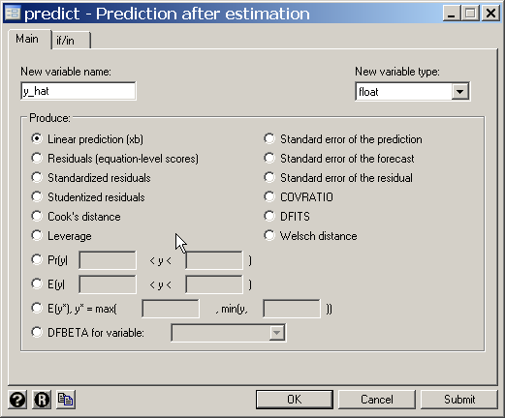

Slide 44
. * Graphics > Twoway graph (scatter, line, etc.)
. twoway scatter bweight estriol /// {2}
> || line y_hat estriol /// {3}
> , xlabel(10 (5) 25) xmtick(7 (1) 27) ytitle("Birth Weight (g/100)") {4}
{2} This command is written over several lines to improve legibility. The three slashes (///) indicate that this command continues on the next line. These slashes are permitted in do files but not in the Command window.
{3} A double bar (||) indicates that another graph is to be overlaid on top of the preceding one. line y_hat estriol indicates that y_hat is to be plotted against estriol with the points connected by a straight line.
{4} This xlabel option labels the x-axis from 10 to 25 in steps of 5. xmtick adds tick marks from 7 to 27 in unit steps. ytitle gives a title to the y-axis

Slide 45
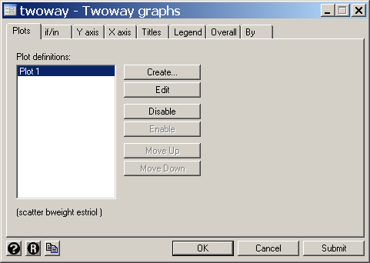
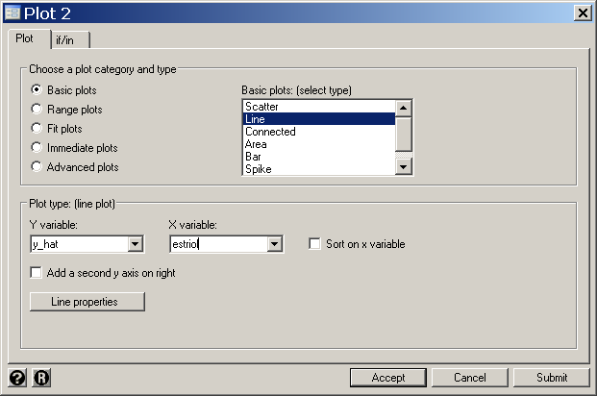

Slide 46
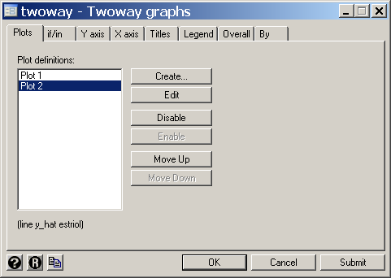
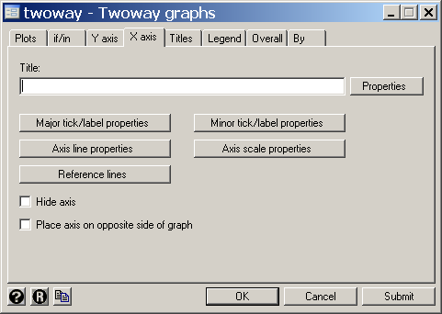
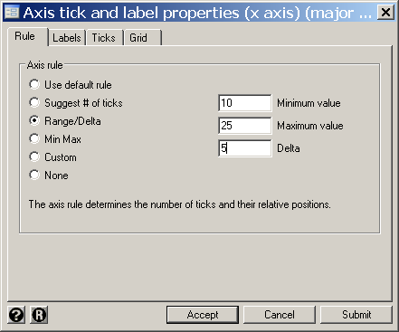

Slide 47
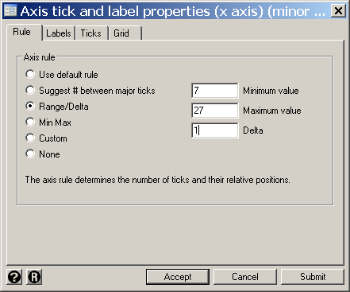

Slide 48
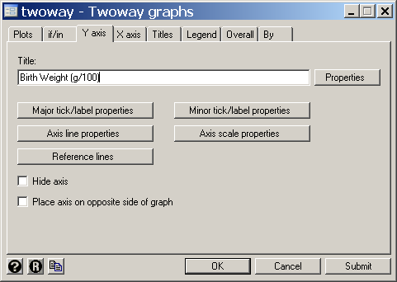

Slide 50
9. 95% Confidence Interval (CI) for β
b + t_{n-2,.025}se(b) = 0.608 + t_{29,.025} × 0.147
= 0.608 + 2.045 × 0.147
= 0.608 + 0.300
= (0.308, 0.908)
Source | SS df MS Number of obs = 31
---------+------------------------------------ F( 1, 29) = 17.16
Model | 250.574476 1 250.574476 Prob > F = 0.0003
Residual | 423.425524 n-2 = 29 s² = 14.6008801 R-squared = 0.3718
---------+------------------------------------ Adj R-squared = 0.3501
Total | 674.00 30 22.4666667 Root MSE = s = 3.8211
------------------------------------------------------------------------------
bweight | Coef. Std. Err. t P>|t| [95% Conf. Interval]
---------+--------------------------------------------------------------------
estriol |b= .6081905 se(b)= .1468117 4.14 P=0.000 .3079268 .9084541
_cons |a= 21.52343 2.620417 8.21 0.000 16.16407 26.88278
------------------------------------------------------------------------------

Slide 51
0.025
-t_{29,.025}
0
t_{29,.025}

Slide 52
10. 95% (CI) for α + βx
Let
The variance of is
{1.8}
The 95% confidence interval for is
{1.9}
Source | SS df MS Number of obs = 31
---------+------------------------------------ F( 1, 29) = 17.16
Model | 250.574476 1 250.574476 Prob > F = 0.0003
Residual | 423.425524 n-2 = 29 s² = 14.6008801 R-squared = 0.3718
---------+------------------------------------ Adj R-squared = 0.3501
Total | 674.00 30 22.4666667 Root MSE = s = 3.8211
------------------------------------------------------------------------------
bweight | Coef. Std. Err. t P>|t| [95% Conf. Interval]
---------+--------------------------------------------------------------------
estriol |b= .6081905 se(b)= .1468117 4.14 P=0.000 .3079268 .9084541
_cons |a= 21.52343 2.620417 8.21 0.000 16.16407 26.88278
------------------------------------------------------------------------------

Slide 53
11. Plotting a 95% Confidence Region for the Expected Response
The listing of Birth_Weight.LR.log continues as follows
. predict std_p, stdp {1}
. * Data > Create or change data > Create new variable
. generate ci_u = y_hat + invttail(_N-2,0.025)*std_p {2}
. generate ci_l = y_hat - invttail(_N-2,0.025)*std_p
{1} The stdp option of the predict command defines std_p to be the error of y_hat.
That is std_p =
{2} invttail calculates a critical value of size α for a t distribution with n degrees of freedom.

Slide 54
. generate ci_u = y_hat + invttail(_N-2,0.025)*std_p
_N denotes the number of variables in the data set, which in this example is 31. Thus invttail(_N-2, 0.025) =
invttail(29, 0.025) = t_{29,0.025} = 2.045

Slide 55
. twoway rarea ci_u ci_l estriol, color(gs14) /// {3,4}
> || scatter bweight estriol ///
> || line y_hat estriol ///
> , xlabel(10 (5) 25) xmtick(7 (1) 27) ytitle("Birth Weight (g/100)")
{3} twoway rarea shades the region between ci_u and ci_l
{4} color selects the color of the shaded region. gs14 is a gray scale. Gray scales vary from gs0 which is black through gs16 which is white.

Slide 56
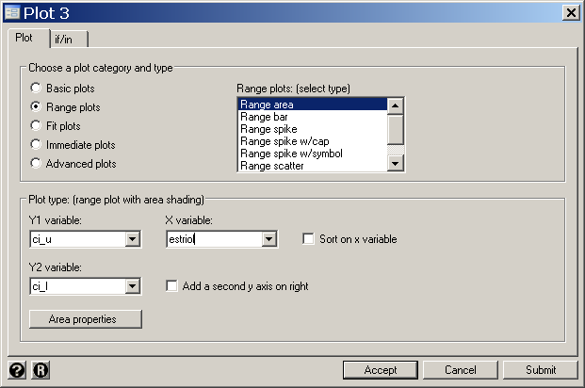
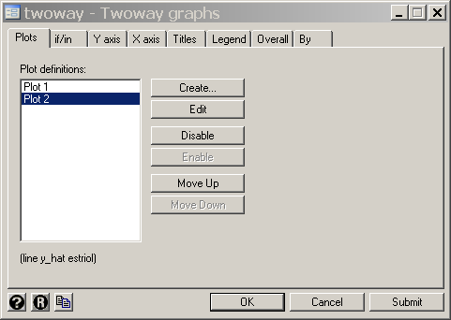
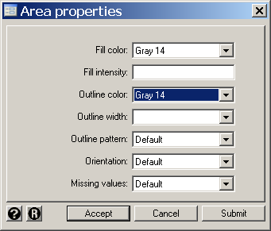

Slide 57
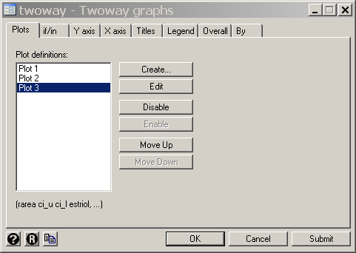
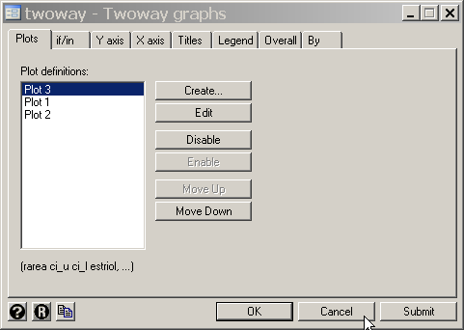

Slide 58
N.B. More than 5% of the observations lie outside of the 95% CI band. Band is for the regression line not the observations.

Slide 59
Is the 95% confidence band for
. predict std_p , stdp
. generate ci_u = y_hat + invttail(_N-2,0.25)*std_p
. generate ci_l = y_hat - invttail(_N-2,0.25)*std_p
. twoway rarea ci_u ci_l estriol, bcolor(gs14)
> || scatter bweight estriol ///
> || line y_hat estriol ///
> , xlabel(10 (5) 25) xmtick(7 (1) 27) ytitle("Birth Weight (g/100)")

Slide 60
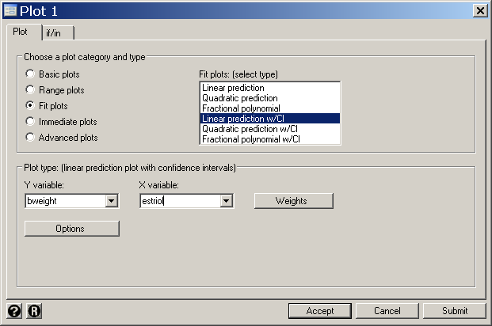
. *
. * The preceding graph could also have been generated without explicitly
. * calculating yhat, ci_u or ci_l as follows
. *
. twoway lfitci bweight estriol /// {1}
> || scatter bweight estriol ///
> , xlabel(10 (5) 25) xmtick(7 (1) 27) ytitle("Birth Weight (g/100)")
{1} lfitci plots both the regression line and the 95% confidence interval for bweight against estriol.

Slide 62
The variance of is
The 95% confidence interval for is

Slide 63
Decreases as n increases
Increases as s increases
Increases as x diverges from
Increases as var(b) increases

Slide 64
12. Distribution of the Sum of Independent Variables.
Suppose that x has mean μ_{x} and variance σ_{x}²
y has mean μ_{y} and variance σ_{y}² and
x and y are independent.
Then x + y has mean μ_{x} + μ_{y} and variance σ_{x}² + σ_{y}²
The 95% CI for the Forecasted Response of a New
Patient
This response is y = a + βx + ε_{i}
The variance of y =
Therefore, a 95% confidence interval for y is
{1,10}

Slide 65
If x = 22 then
= 14.6009/31 + (22 - 17.226)² x 0.1468² = 0.9621
= 21.523 + 0.6082 x 22 = 34.903
95% C.I. for (x) = 34.903 + t_{29,.025} x
= 34.903 + 2.045 x 0.981
= (32.9, 36.9)
Source | SS df MS Number of obs = 31
---------+------------------------------------ F( 1, 29) = 17.16
Model | 250.574476 1 250.574476 Prob > F = 0.0003
Residual | 423.425524 n-2 = 29 s² = 14.6008801 R-squared = 0.3718
---------+------------------------------------ Adj R-squared = 0.3501
Total | 674.00 30 22.4666667 Root MSE = s = 3.8211
------------------------------------------------------------------------------
bweight | Coef. Std. Err. t P>|t| [95% Conf. Interval]
---------+--------------------------------------------------------------------
estriol |b= .6081905 se(b)= .1468117 4.14 P=0.000 .3079268 .9084541
_cons |a= 21.52343 2.620417 8.21 0.000 16.16407 26.88278
------------------------------------------------------------------------------

Slide 66
95% C.I. for y at x =
If x = 22 then
= 0.9621
= 34.903
95% C.I. for y at x = 34.903 + 2.045 x
= (26.8, 43.0)
Source | SS df MS Number of obs = 31
---------+------------------------------------ F( 1, 29) = 17.16
Model | 250.574476 1 250.574476 Prob > F = 0.0003
Residual | 423.425524 n-2 = 29 s² = 14.6008801 R-squared = 0.3718
---------+------------------------------------ Adj R-squared = 0.3501
Total | 674.00 30 22.4666667 Root MSE = s = 3.8211
------------------------------------------------------------------------------
bweight | Coef. Std. Err. t P>|t| [95% Conf. Interval]
---------+--------------------------------------------------------------------
estriol |b= .6081905 se(b)= .1468117 4.14 P=0.000 .3079268 .9084541
_cons |a= 21.52343 2.620417 8.21 0.000 16.16407 26.88278
------------------------------------------------------------------------------

Slide 67
14. Plotting 95% Confidence Intervals for Forecasted Responses
The listing of Birth_Weight.LR.log continues as follows
. predict std_f , stdf {1}
. generate ci_uf = y_hat + invttail(_N-2,0.025)*std_f
. generate ci_lf = y_hat - invttail(_N-2,0.025)*std_f
. twoway lfitci bweight estriol
> || scatter bweight estriol ///
> || line ci_uf estriol, color(red) /// {2}
> || line ci_lf estriol, color(red) ///
> , xlabel(10 (5) 25) xmtick(7 (1) 27) ///
> ytitle("Birth Weight (g/100)") legend(off) {3}
{1} predict defines std_f to be the forecasted error of y.
That is std_f =
{2} rline plots both ci_uf and ci_lf against estriol.
color specifies the color of the plotted lines.
When plotting non-linear lines, it is important that the data be sorted by the x-variable. .
{3} legend(off) eliminates the legend from the graph

Slide 68
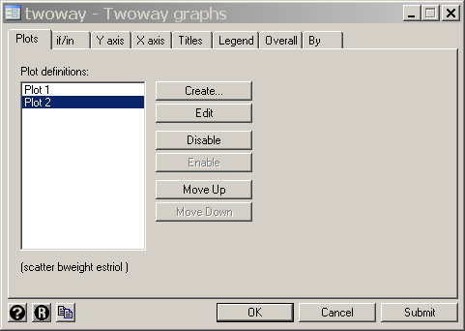
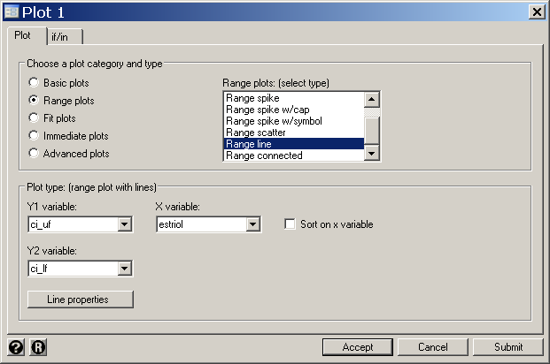
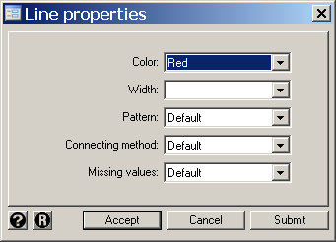

Slide 69
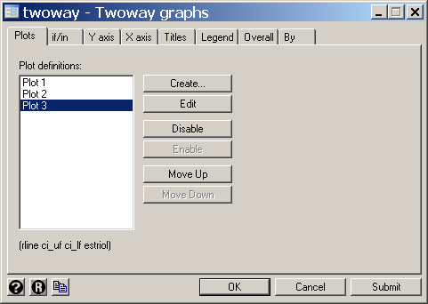
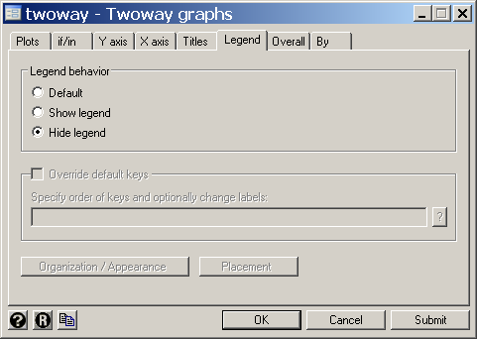

Slide 71
15. Lowess Regression
Linear regression is a useful tool for describing a relationship that is linear, or approximately linear. It has the disadvantage that the linear relationship is assumed a priori. It is often useful to fit a line through a scatterplot that does not make any model assumptions. One such technique is lowess regression, which stands for locally weighted scatterplot smoothing. The idea is that for each observation (x_{i}, y_{i}) is fitted to a separate linear regression line based on adjacent observations. These points are weighted so that the farther away the x value is from x_{i}, the less effect it has on determining the estimate of . The proportion of the total data set considered for each is called the bandwidth. In Stata the default bandwidth is 0.8, which works well for small data sets. For larger data sets a bandwidth of 0.3 or 0.4 usually works better.
On large data sets lowess is computationally intensive.

Slide 72
16. Plotting a Lowess Regression Curve in Stata
We can now compare the lowess and linear curves.
The listing of Birth_Weight.LR.log continues as follows
.twoway scatter bweight estriol ///
> || lfit bweight estriol /// {1}
> || lowess bweight estriol , bwidth(.8) /// {2}
> , xlabel(10 (5) 25) xmtick(7 (1) 27) ytitle("Birth Weight (g/100)")
{1} This lfit command plots the linear regression line for bweight against estriol.
{2} This lowess command plots the lowess regression line for bweight against estriol. bwidth(.8) specifies a bandwidth of .8
This comparison suggests that the linear model is fairly reasonable.

Slide 73

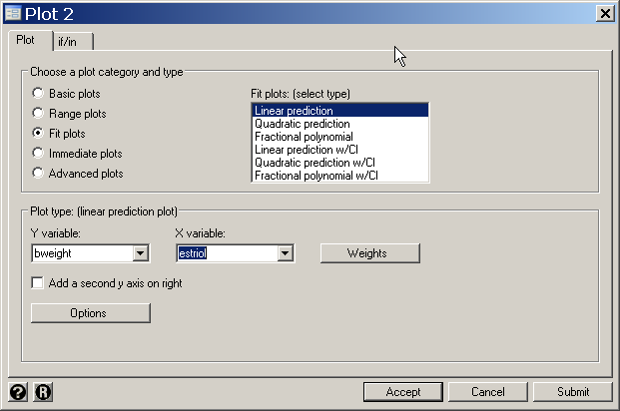

Slide 74

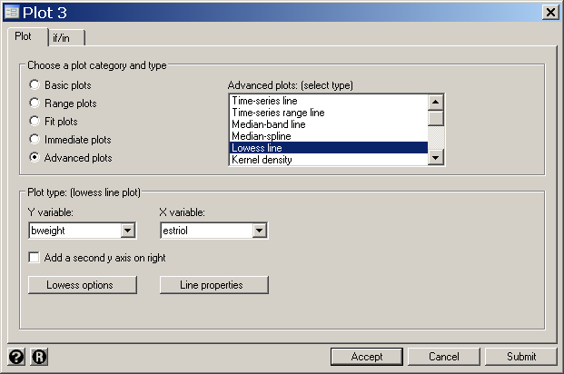

Slide 76
Residuals, Standard Error Of Residuals, And
Studentized Residuals
The residual e_{i} = y_{i} - (a + bx_{i})
has variance var(e_{i}) =
The corresponding to the point
Standardized residual
(x_{i}, y_{i}) is e_{i} /
{1.11}
A problem with Equation {1.11} is that a single large residual can
Inflate the value of s²
Decrease the size of the standardized residuals
Can pull towards y_{i}

Slide 77
To avoid this problem, we usually calculate the
studentized residual
{1.12}
where
denotes the root MSE estimate of
with the
case deleted and
is the variance of
measured in units of
is called the
leverage
of the
observation.
is sometimes referred to as the jackknife residual
Plotting these studentized residuals against
assesses the
homoscedasticity assumption.

Slide 78

The listing of Birth_Weight.LR.log continues as follows
. predict residual, rstudent {1}
{1} Define residual to be a new variable that equals the studentized residual.

Slide 79


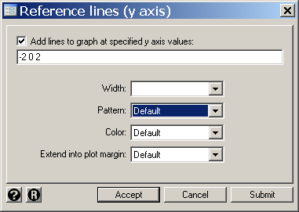
. twoway scatter residual estriol ///
> || lowess residual estriol ///
> , ylabel(-2 (1) 2) yline(-2 0 2) xlabel(10 (5) 25) /// {2}
> xmtick(7 (1) 27)
{2} The yline option adds horizontal grid lines at specified values on the y-axis.

Slide 80
This graph hints at a slight departure from linearity for large estriol levels. There is also a slight suggestion of increasing variance with increasing estriol levels, although the dispersion is fairly uniform if you disregard the patients with the lowest three values of estriol. Three of 31 residuals (9.6%) have a magnitude of 2 or greater. A large data set from a true linear model should have 5% of their residuals outside this range.

Slide 81
18. Variance Stabilizing Transformations
a)
Square root transform
Useful when the residual variance is proportional to the expected value.
b)
Log transform
Useful when the residual standard deviation is proportional to the expected value.
N.B.
Transformations that stabilize variance may cause non-linearity. In this case it may be necessary to use a non-linear regression technique.
19. Normalizing the Data Distribution
For skewed data we can often improve the quality of our model fit by transforming the data to give the residuals a more normal distribution.
For example, log transforms can normalize data that is right skewed.

Slide 82
The figure shows common patterns on non-linearity between x and y variables.
20. Correcting for Non-linearity

Slide 83
If x is positive then models of the form
{1.13}
{1.14}
{1.15}
should be considered for some p > 1.
A
B
b
g
)
)
y
=
a
+
b
x
p
+
e
y
y
i
i
i
(
(
E
E
y
=
a
+
b
b
x
g
p
+
e
i
i
i
0
x
0
x
Data similar to panels A and B of this figure may be modeled with equation {1.13}

Slide 84
If x is positive then models of the form
{1.13}
{1.14}
{1.15}
should be considered for some p > 1.
E( y)
E( y)
C
D
0
x
0
x
Data similar to panels C and D may be modeled with equations {1.14} and {1.15}.
The best value of p is found empirically.

Slide 85
Alternately, data similar to panels A or C may be modeled with
A
{1.16}
or
{1.17}
E( y)
0
x
E( y)
C
0
x

Slide 86
Data similar to panels B or D may be modeled with
{1.18}
B
E( y)
0
x
E( y)
D
0
x

Slide 87
21. Example: Research Funding and Morbidity for 29 Diseases
Gross et al. (1999) studied the relationship between NIH research funding for 29 different diseases and disability-adjusted person-years of life lost due to these illnesses.
(IHD)
Disability-Adjusted Life-Years Lost (millions)
Figure A shows the untransformed scatter plot. Funding for AIDS is 3.7 times higher than for any other disease

Slide 88
IHD
Disability-Adjusted Life-Years Lost (millions)
Figure B is similar to panel A except the AIDS data has been deleted and the y-axis has been re-scaled.
This scatter plot has a concave shape, which suggest using a log or power transform (equations 1.14 or 1.15).

Slide 89
IHD
Disability-Adjusted Life-Years Lost (millions)
Figure C shows funding plotted against log disability-adjusted life-years.
The resulting scatter plot has a convex shape.
This suggest either using a less concave transform of the x-axis or using a log transform of the y-axis.

Slide 90
IHD
Disability-Adjusted Life-Years Lost (millions)
In Figure D we plot log funding against log disability.
The relationship between these transformed variables is now quite linear.
AIDS remains an outlier but is far less discordant with the other diseases than it is in panel A.
The linear regression line and associated 95% confidence intervals are shown in this panel.

Slide 91
IHD
Disability-Adjusted Life-Years Lost (millions)
The model for this linear regression is
{1.19}
where y_{i} and x_{i} are the research funds and disability-adjusted life-years lost for the i^{th} disease, respectively.

Slide 92
IHD
Disability-Adjusted Life-Years Lost (millions)
The slope estimate is β = 0.48, which differs from zero with overwhelming statistical significance.
Gross et al. (1999) published a figure that is similar to panel D.

Slide 93
Ischemic heart disease
Disability-Adjusted Life-Years Lost (millions)
The relationship between funding and life-years lost is more easily understood in Panel E, which uses the untransformed data.
If is the estimated regression line for the model specified by Equation (1.19) then the predicted funding level for the i^{th} disease is
To draw this graph we would use the twoway rarea command

Slide 94
22. Testing the Equality of Regression Slopes
Suppose that y_{i1} = α₁ + β₁x_{i1} + ε_{i1} and
y_{i2} = α₂ + β₂x_{i2} + ε_{i2}
where ε_{ij} is assumed to be normally and independently distributed with mean 0 and standard deviation σ.
We wish to test the null hypothesis that β₁ = β_{2.}

Slide 95
The pooled estimate of σ² is
s² =
= {1.20}
Since and
var (b₁ – b₂) =
{1.21}
But var (b₁) = and hence
= / var(b₁)
Therefore var(b₁ - b₂) = s²(var(b₁)/ +var(b₂)/ )
t = (b₁ - b₂)/
{1.22}
has a t distribution with n₁ + n₂ – 4 degrees of freedom.
A 95% CI for β₁ - β₂ is (b₁ – b₂)

Slide 96
To compute the preceding statistic we run two separate linear regressions on group 1 and 2.
For group 1, s₁ is the root MSE and is the standard error of the slope estimate.
s₂ and var(b₂) are similarly defined for group 2.
Substituting these values into the formulas from the previous slide gives the required test.

Slide 97
23. Comparing Linear Regression Slopes with Stata
* FramSBPbmiSex.log
. *
. * Regression of systolic blood pressure against
. * body mass index for men and women in the
. * Framingham Heart Study. (Levy 1999)
. *
. use "c:\WDDtext\2.20.Framingham.dta", clear
. codebook sex {1}
sex ------------------------------------------------ sex
type: numeric (float)
label: sex
range: [1,2] units: 1
unique values: 2 coded missing: 0 / 4699
tabulation: Freq. Numeric Label
2049 1 Men
2650 2 Women
{1} The codebook command provides a summary of variables. sex takes numeric values 1 and 2 that denote men and women, respectively.

Slide 98
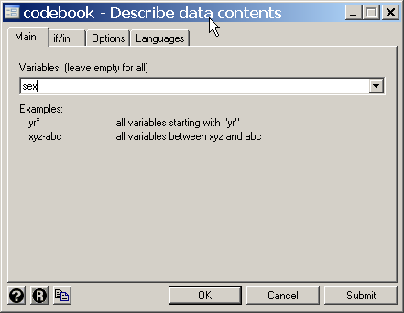

Slide 99
. regress sbp bmi if sex == 1 {2}
Source | SS df MS Number of obs = 2047
---------+------------------------------ F( 1, 2045) = 121.09
Model | 44504.0296 1 44504.0296 Prob > F = 0.0000
Residual | 751572.011 2045 367.516876 R-squared = 0.0559
---------+------------------------------ Adj R-squared = 0.0554
Total | 796076.041 2046 389.088974 Root MSE = 19.171
------------------------------------------------------------------------------
sbp | Coef. Std. Err. t P>|t| [95% Conf. Interval]
---------+--------------------------------------------------------------------
bmi | 1.375953 .1250382 11.004 0.000 1.130738 1.621168
_cons | 96.43061 3.272571 29.466 0.000 90.01269 102.8485
------------------------------------------------------------------------------
. predict yhatmen, xb
(9 missing values generated)
Comment {2}
This command regresses sbp against bmi in men only. Note that Stata distinguishes between a = 1, which assigns the value 1 to a, and a==1 which is a logical expression that is true if the a equals 1 and is false otherwise.

Slide 100
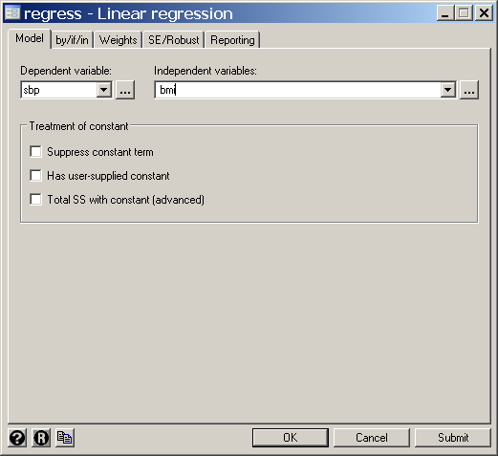
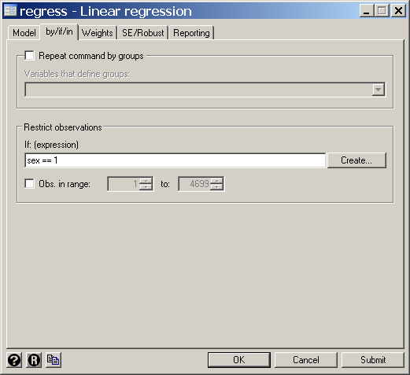

Slide 101
. regress sbp bmi if sex == 2
Source | SS df MS Number of obs = 2643
---------+------------------------------ F( 1, 2641) = 428.48
Model | 229129.452 1 229129.452 Prob > F = 0.0000
Residual | 1412279.85 2641 534.751932 R-squared = 0.1396
---------+------------------------------ Adj R-squared = 0.1393
Total | 1641409.31 2642 621.275286 Root MSE = 23.125
------------------------------------------------------------------------------
sbp | Coef. Std. Err. t P>|t| [95% Conf. Interval]
---------+--------------------------------------------------------------------
bmi | 2.045966 .0988403 20.700 0.000 1.852154 2.239779
_cons | 81.30435 2.548909 31.898 0.000 76.30629 86.30241
------------------------------------------------------------------------------
. predict yhatwom, xb
(9 missing values generated)

Slide 102
. sort bmi
. *
. * Scatter plot with expected sbp for women
. *
. scatter sbp bmi if sex==2 , symbol(Oh) /// {1}
> || lfit sbp bmi if sex==2 ///
> , lpattern(dash) xlabel(15 (15) 60) /// {2}
> ylabel( 100 (50) 250 ) ytitle(Systolic Blood Pressure)
{1} symbol specifies the marker symbol used to specify individual observations. Oh indicates that a hollow circle is to be used.
{2} lpattern(dash) specifies that a dashed line is to be drawn.

Slide 103

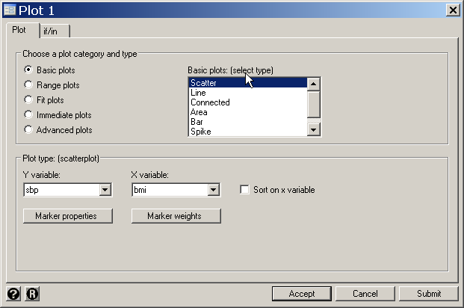
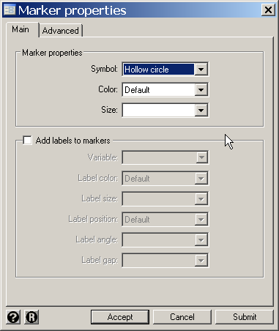

Slide 104

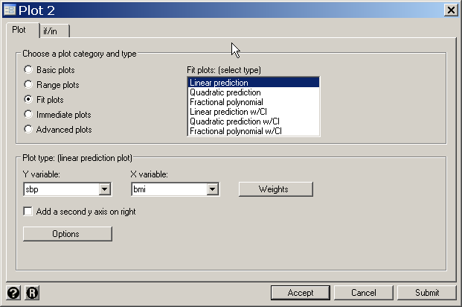
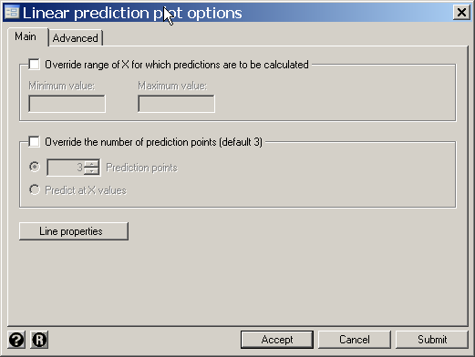
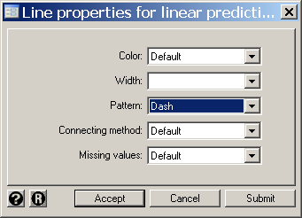

Slide 106
. *
. * Scatter plot with expected logsbp for men
. *
. scatter sbp bmi if sex==1 , symbol(Oh) ///
> || lfit sbp bmi if sex==1 ///
> , clpat(dash) xlabel(15 (15) 60) ///
> ylabel( 100 (50) 250 ) ytitle(Systolic Blood Pressure)

Slide 107
. scatter sbp bmi , symbol(Oh) color(gs10) /// {1}
> || line yhatmen bmi if sex == 1, lwidth(medthick) /// {2}
> || line yhatwom bmi, lwidth(medthick) lpattern(dash) ///
> ||, by(sex) ytitle(Systolic Blood Pressure) xsize(8) /// {3}
> ylabel( 100 (50) 250) ytick(75 (25) 225) ///
> xtitle(Body Mass Index) xlabel( 15 (15) 60) xmtick(20 (5) 55) ///
> legend(order(1 "Observed" 2 "Expected, Men" 3 /// {4}
> "Expected, Women") rows(1)) {5}
{1} color specifies the marker color used to specify individual observations. gs10 indicates a gray is to be used. A gray scale of 0 is black; 16 is white.
{2} lwidth(medthick) specifies width for the line
{3} xsize specifies the width of the graph in inches
{4} legend controls the graph legend. order specifies the legend keys to be displayed and the labels assigned to these keys. The keys are indicated by the numbers 1, 2, 3, etc that are assigned in the order that they are defined.
{5} rows(1) specifies that we want the legend displayed in a single row

Slide 108

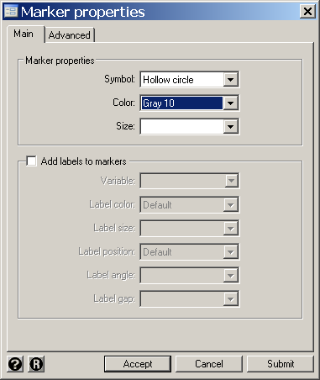

Slide 109

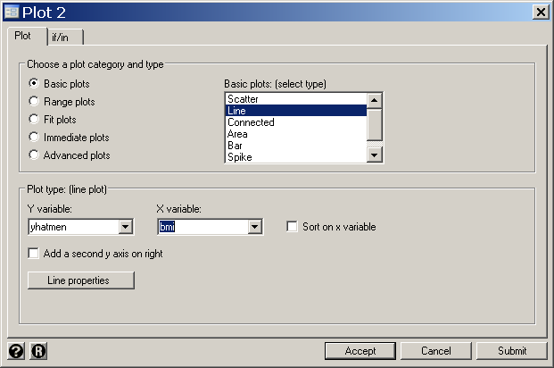
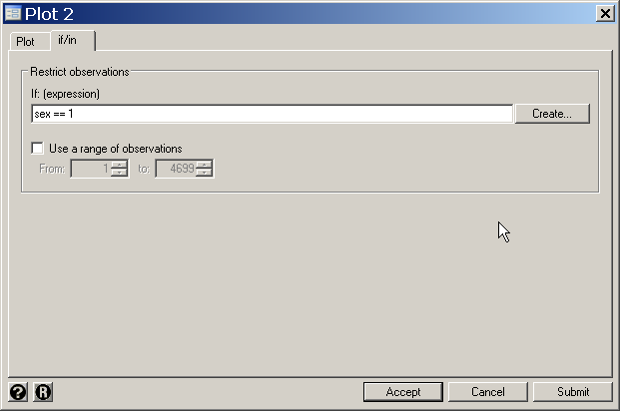
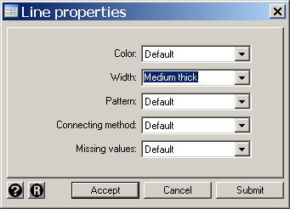

Slide 110

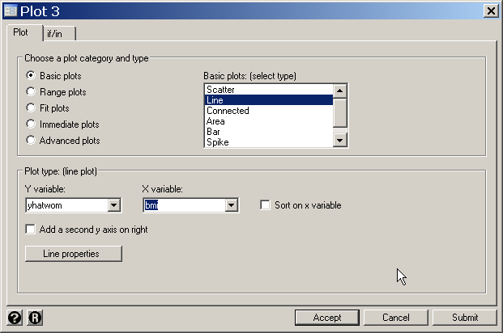
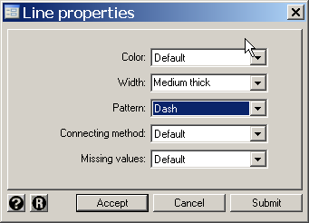

Slide 111

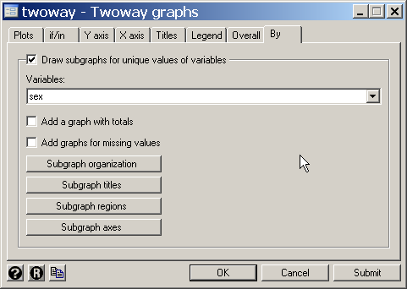
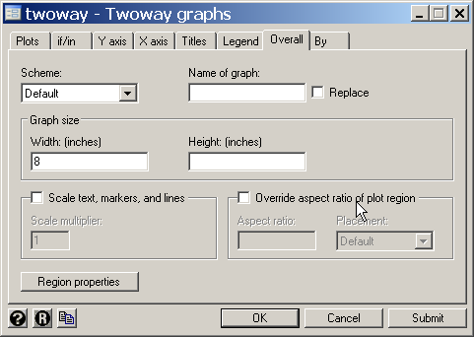

Slide 112
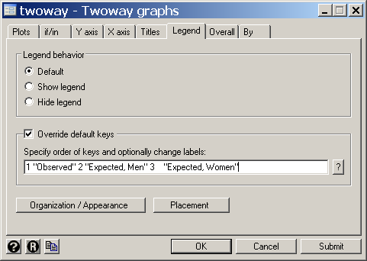
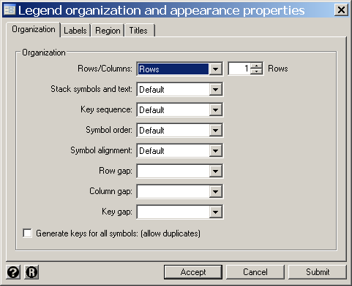

Slide 113
For a body mass index of 40, the expected SBPs for men and women are 96.43 + 40 x 1.38 = 152 and 81.30 + 40 x 2.05 = 163, respectively.
Is it plausible that the effect of BMI on blood pressure is different in men and women?

Slide 114
To test the equality of the slopes from the standard and experimental preparations, we note that
s² =
= 367.52 × (2047 – 2) + 534.75 × (2643 – 2)
2047 + 2643 – 4
= 461.77
Men
Source | SS df MS Number of obs = 2047
---------+------------------------------ F( 1, 2045) = 121.09
Model | 44504.0296 1 44504.0296 Prob > F = 0.0000
Residual | 751572.011 2045 367.516876 R-squared = 0.0559
---------+------------------------------ Adj R-squared = 0.0554
Total | 796076.041 2046 389.088974 Root MSE = 19.171
------------------------------------------------------------------------------
sbp | Coef. Std. Err. t P>|t| [95% Conf. Interval]
---------+--------------------------------------------------------------------
bmi | 1.375953 .1250382 11.004 0.000 1.130738 1.621168
_cons | 96.43061 3.272571 29.466 0.000 90.01269 102.8485
------------------------------------------------------------------------------

Slide 115
To test the equality of the slopes from the standard and experimental preparations, we note that
s² =
= 367.52 × (2047 – 2) + 534.75 × (2643 – 2)
2047 + 2643 – 4
= 461.77
Women
Source | SS df MS Number of obs = 2643
---------+------------------------------ F( 1, 2641) = 428.48
Model | 229129.452 1 229129.452 Prob > F = 0.0000
Residual | 1412279.85 2641 534.751932 R-squared = 0.1396
---------+------------------------------ Adj R-squared = 0.1393
Total | 1641409.31 2642 621.275286 Root MSE = 23.125
------------------------------------------------------------------------------
sbp | Coef. Std. Err. t P>|t| [95% Conf. Interval]
---------+--------------------------------------------------------------------
bmi | 2.045966 .0988403 20.700 0.000 1.852154 2.239779
_cons | 81.30435 2.548909 31.898 0.000 76.30629 86.30241
------------------------------------------------------------------------------

Slide 116
= / var(b₁) = 367.52/0.12504² = 23506
Men
Source | SS df MS Number of obs = 2047
---------+------------------------------ F( 1, 2045) = 121.09
Model | 44504.0296 1 44504.0296 Prob > F = 0.0000
Residual | 751572.011 2045 367.516876 R-squared = 0.0559
---------+------------------------------ Adj R-squared = 0.0554
Total | 796076.041 2046 389.088974 Root MSE = 19.171
------------------------------------------------------------------------------
sbp | Coef. Std. Err. t P>|t| [95% Conf. Interval]
---------+--------------------------------------------------------------------
bmi | 1.375953 .1250382 11.004 0.000 1.130738 1.621168
_cons | 96.43061 3.272571 29.466 0.000 90.01269 102.8485
------------------------------------------------------------------------------

Slide 117
/ var(b₂)
= = 534.75/0.09884² = 54738
Women
Source | SS df MS Number of obs = 2643
---------+------------------------------ F( 1, 2641) = 428.48
Model | 229129.452 1 229129.452 Prob > F = 0.0000
Residual | 1412279.85 2641 534.751932 R-squared = 0.1396
---------+------------------------------ Adj R-squared = 0.1393
Total | 1641409.31 2642 621.275286 Root MSE = 23.125
------------------------------------------------------------------------------
sbp | Coef. Std. Err. t P>|t| [95% Conf. Interval]
---------+--------------------------------------------------------------------
bmi | 2.045966 .0988403 20.700 0.000 1.852154 2.239779
_cons | 81.30435 2.548909 31.898 0.000 76.30629 86.30241
------------------------------------------------------------------------------
var(b₁ – b₂) =
= 461.77 × (1/23506 + 1/54738) = 0.02808

Slide 118
t = (1.3760 – 2.0460) /
= -4.00 with 4686 degrees of freedom. P = 0.00006
= 2 × ttail(4686,4)
A 95% CI for b₁ – b₂ is
1.3760 – 2.0460
= -0.67 + 1.96×0.1676
= (-1.0, -0.34)
±
t
0.02808
4686,0.025

Slide 119
24. Analyzing Subsets in Stata
The previous example illustrated how to restrict analyses to a subgroup such as men or women. This can be extended to more complex selections. Suppose that sex = 1 for males, 2 for females and that age = 1 for people < 10 years old,
= 2 for people 10 to 19 years old, and
= 3 for people ≥ 20 years old. Then
sex==2 & age != 2 selects females who are not 10 to 19 years old. If there are no missing values this is equivalent to
sex==2 & (age==1 | age == 3)
sex==1 | age==3 selects all men plus all women ≥ 20.
Logical expressions may be used to define new variables (generate command) , to drop records from the data set (keep or drop command) or to restrict the data used by analysis commands such as regress.
Logical expressions evaluate to 1 if true, 0 if false. Stata considers any non-zero value to be true.

Slide 120
Logical expressions may be used to keep or drop observations from the data. For example
. keep sex == 2 & age == 1
will keep young females and drop all other observations from memory
. drop sex == 2 | age == 1
will drop women and young people keeping males > 10 years old.
. regress sbp bmi if age == 1 | age == 3
will regress sbp against bmi for people who are less than 10 or at least 20 years of age.

Slide 121
24. What we have covered.
Distinction between a parameter and a statistic
The normal distribution
Inference from a known sample about an unknown target population
Simple linear regression: Assessing simple relationships between two continuous variables
Interpreting the output from a linear regression program. Analyzing data with Stata
Plotting linear regression lines with confidence bands
Making inferences from simple linear regression models
Lowess regression and residual plots. How do you know you have the right model?
Transforming data to improve model fit
Comparing slopes from two independent linear regressions

Slide 122
Cited References
Greene JW, Jr., Touchstone JC. Urinary estriol as an index of placental function. A study of 279 cases. Am J Obstet Gynecol 1963;85:1-9.
Gross, C. P., G. F. Anderson, et al. (1999). "The relation between funding by the National Institutes of Health and the burden of disease." N Engl J Med 340(24): 1881-7.
Levy D, National Heart Lung and Blood Institute., Center for Bio-Medical Communication. 50 Years of Discovery : Medical Milestones from the National Heart, Lung, and Blood Institute's Framingham Heart Study. Hackensack, N.J.: Center for Bio-Medical Communication Inc.; 1999.
Rosner B. Fundamentals of Biostatistics. 6th ed. Belmont CA: Danbury 2006
For additional references on these notes see.
Dupont WD. Statistical Modeling for Biomedical Researchers: A Simple Introduction to the Analysis of Complex Data. 2nd ed. Cambridge, U.K.: Cambridge University Press; 2009.

